Slide 1
SOFTWARE ENGINEERING CONCEPT
Project Management Concepts

Slide 2
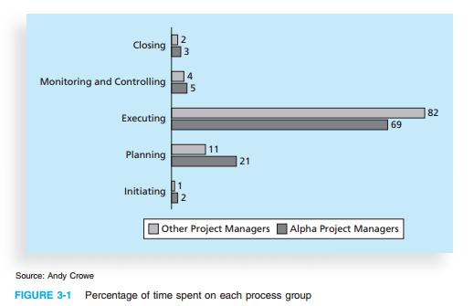
Importance of Project Planning (860 projects data in US collected)

Slide 3
Project Management Knowledge areas
Project integration management
Project scope management
Project time management
Project cost management
Project quality management
Project Human Resource Management
Project communication management

Slide 4
Cont…
Project risk management
Project procurement management
Project stakeholder management

Slide 5
Case Study: Applying Project Management Steps To A Project

Slide 6
CASE STUDY: (JWD Consulting’s Project Management Intranet Site Project)
Erica Bell is in charge of the Project Management Office (PMO) for her consulting firm, JWD Consulting, which has grown to include more than 200 full-time consultants and even more part-time consultants. (JWD stands for Job Well Done.) JWD Consulting provides a variety of consulting services to assist organizations in selecting and managing IT projects. The firm focuses on finding and managing high-payoff projects and developing strong metrics to measure project performance and benefits to the organization after the project is implemented. The firm’s emphasis on metrics and working collaboratively with its customers gives it an edge over many competitors.
Joe Fleming, the CEO, wants his company to continue to grow and become a world-class consulting organization. Because the core of the business is helping other organizations with project management, he felt it was crucial for JWD Consulting to have an exemplary process for managing its own projects. He asked Erica to work with her team and other consultants in the firm to develop several intranet site applications that would allow them to share their project management knowledge. He also thought that the firm should make some of the information available to the firm’s clients. For example, the firm could provide project management templates, tools, articles, links to other sites, and an “Ask the Expert” feature to help build relationships with current and future clients. Because JWD Consulting emphasizes the importance of high-payoff projects, Joe also wanted to see a business case for this project before proceeding
Notes:
Chapter 3, page 91-121 Book “IT Project Management”

Slide 7
1.Pre-Initiation Tasks
Determine the scope, time, and cost constraints for the project
Identify the project sponsor
Select the project manager
Develop a business case for a project
Meet with the project manager to review the process and expectations for managing the project
Determine if the project should be divided into two or more smaller projects

Slide 8
2. Initiating
Identify project stakeholders
Erica documented the stakeholders’ roles, names, organizations, and contact information in a stakeholder register, a document that includes details related to the identified project stakeholders.
Develop Project Charter
Kick-start meeting

Slide 9
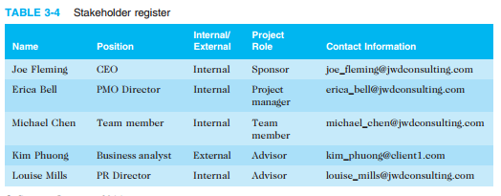
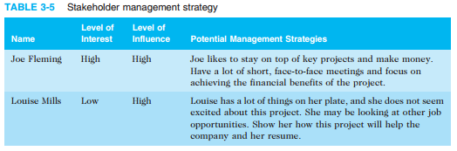
a. Stakeholders management

Slide 10
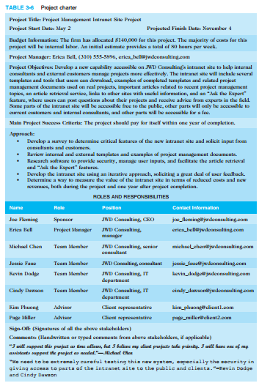
b. Draft The Project Charter

Slide 11
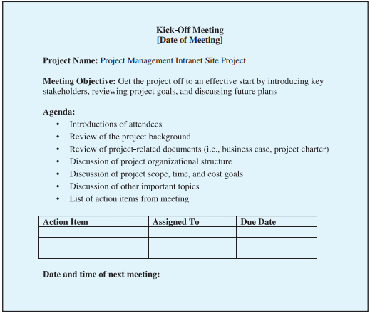
c. Holding a Project Kick-off Meeting

Slide 12
2. Project Planning
A team contract
A project scope statement
A work breakdown structure (WBS), a key part of the scope baseline
A project schedule, in the form of a Gantt chart with all dependencies and resources entered
A list of prioritized risks (part of a risk register)

Slide 13
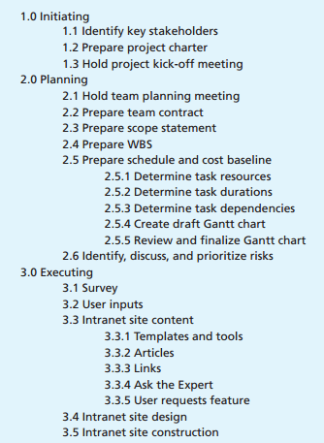
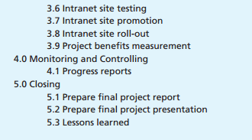
Work Break Down Structure

Slide 14
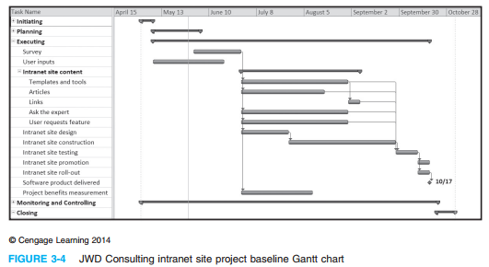
Gant Chart

Slide 15
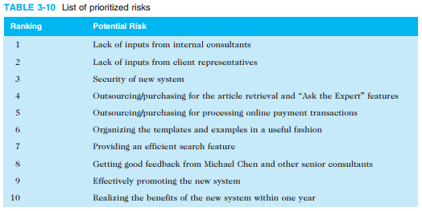
Priority wise List of Risks

Slide 16
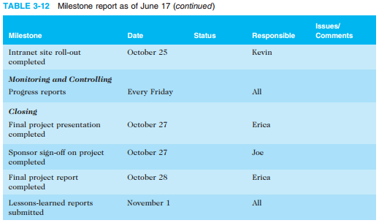
3. Project Execution

Slide 17
4. Project Monitoring and Controlling
Key focus of 9 knowledge areas.

Slide 18
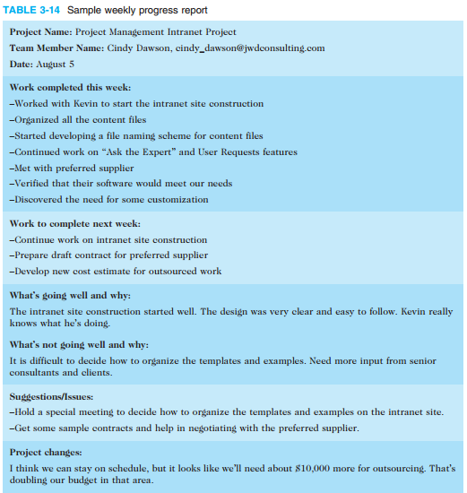
Weekly progress report

Slide 19
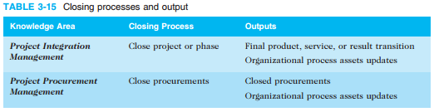
5. Project Closing
Closing report
Lesson learned report
Final project report

Slide 20
Network Diagram

Slide 21
What is Network Diagram
A visual representation of project activities and the order they must be completed.
Shows tasks (activities) as nodes or arrows and dependencies between them.
Helps in scheduling and identifying the critical path in CPM.

Slide 22
Why Use a Network Diagram
Understand task flow and sequence.
Determine project duration.
Identify parallel and sequential tasks.
Find the critical path (tasks that must be completed on time).

Slide 23
Components of a Network Diagram
Activities (Tasks): Represented as boxes (nodes) or arrows.
Dependencies: Arrows showing which task depends on another.
Start and End Nodes: Represent project beginning and completion.

Slide 24
Types of Network Diagrams
Activity on Node (AON) – Tasks are shown in boxes.
Activity on Arrow (AOA) – Tasks are shown on arrows.
AON is most commonly used in modern project management tools

Slide 25
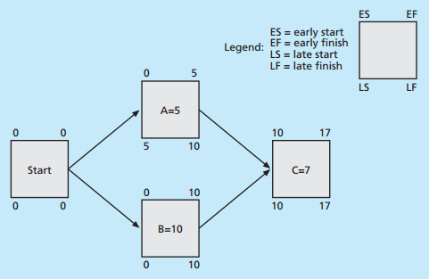
Activity on Node (AON)

Slide 26
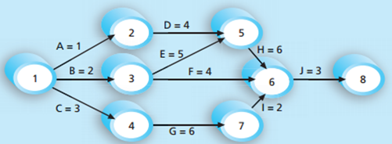
Activity on Arrow (AOA)

Slide 27
Critical Path Method (CPM)

Slide 28
What is CPM
A project management technique used to schedule project activities.
Helps in identifying:
Critical tasks
Total project duration
Slack time for tasks
Widely used in construction, software development, and engineering projects.

Slide 29
Why Use CPM?
Improves time management.
Identifies essential tasks.
Helps in resource allocation.
Highlights project risks due to tight deadlines.

Slide 30
Steps in CPM
List all activities in the project.
Determine dependencies (which tasks must come before others).
Estimate the duration of each activity.
Draw a network diagram.
Calculate the earliest and latest start and finish times.
Identify the critical path.

Slide 31
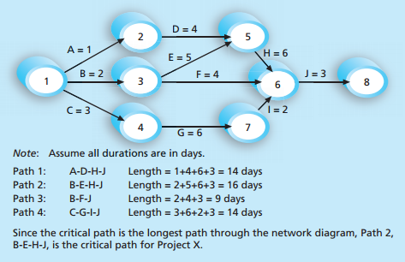
Network Diagram & Calculating CPM

Slide 32
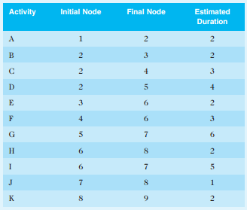
Network Diagram for a small project (Practice Question)

Slide 33
Cont…
Draw an AOA network diagram representing the project.
Identify all of the paths on the network diagram and note how long they are.
What is the critical path for this project and how long is it?
What is the shortest possible time needed to complete this project?

Slide 34
Sample Problem (Basic)
Task A: 3 days → B: 4 days (after A) → C: 2 days (after B)
Task D: 5 days (starts with A)
Task E: 1 day (after C and D)
Question: What is the critical path and total duration?

